Slide 1
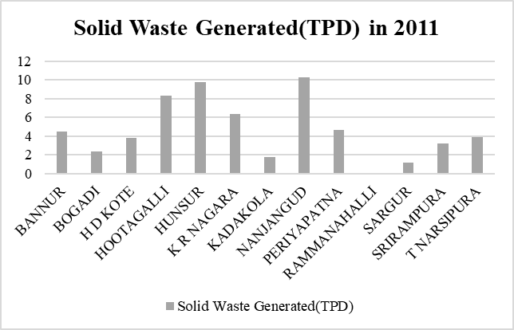
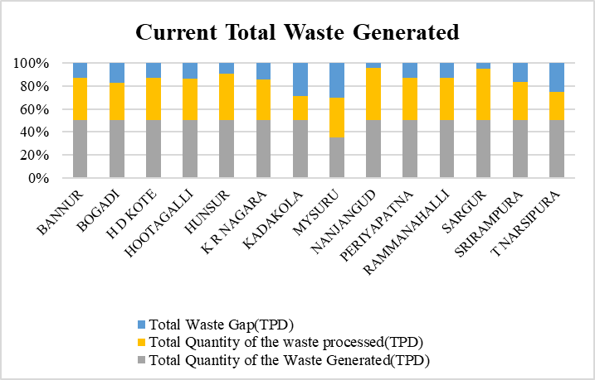
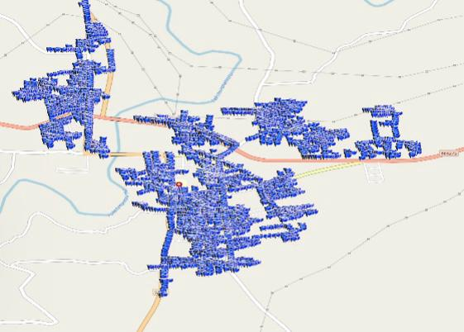
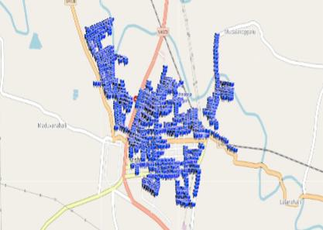
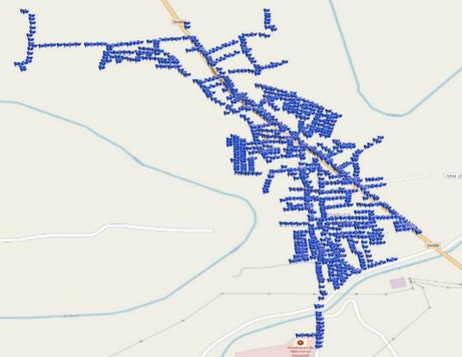
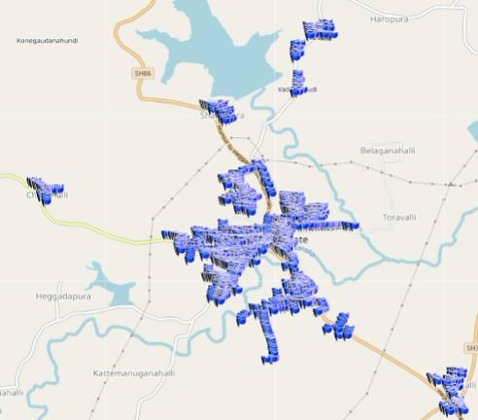
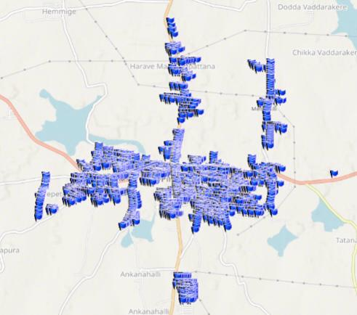
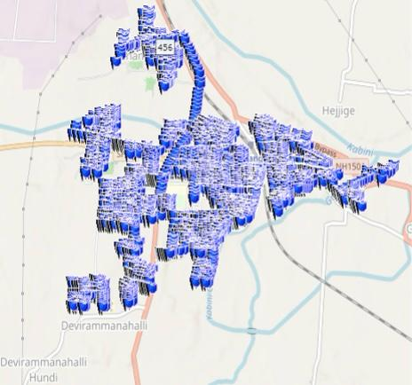
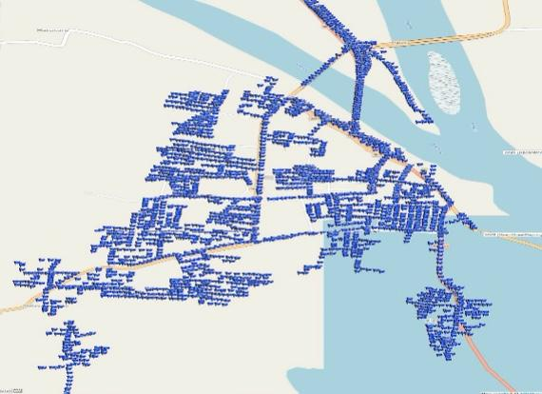
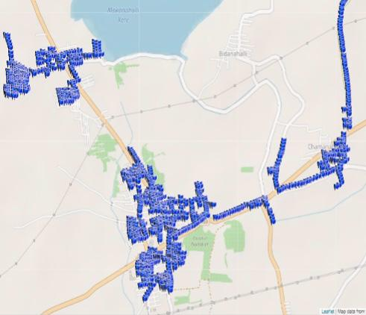
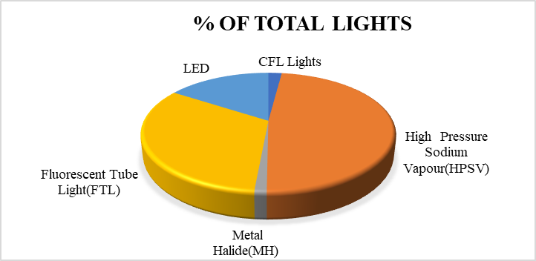
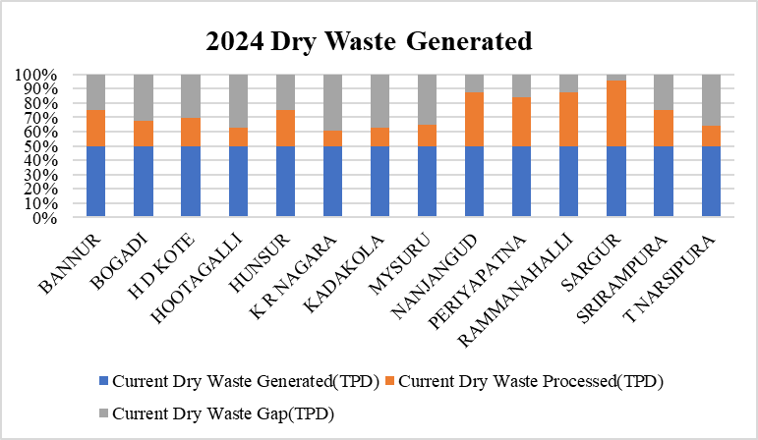
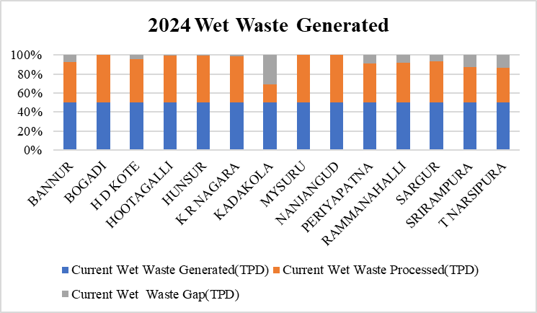
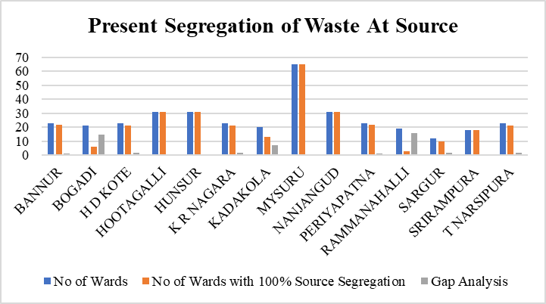
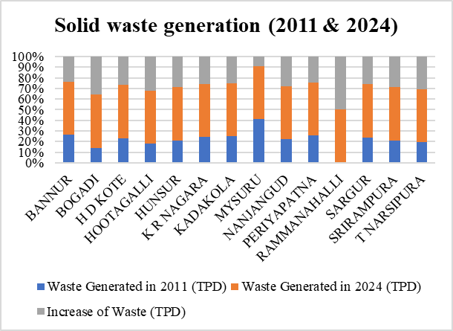
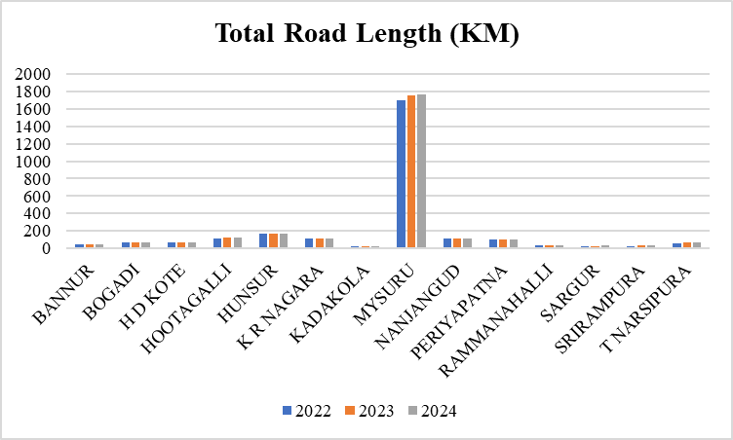
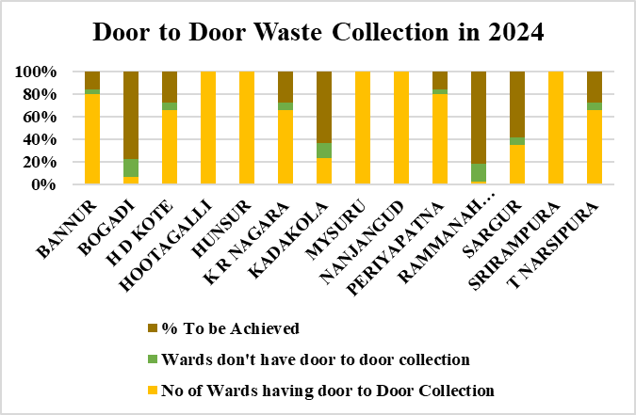
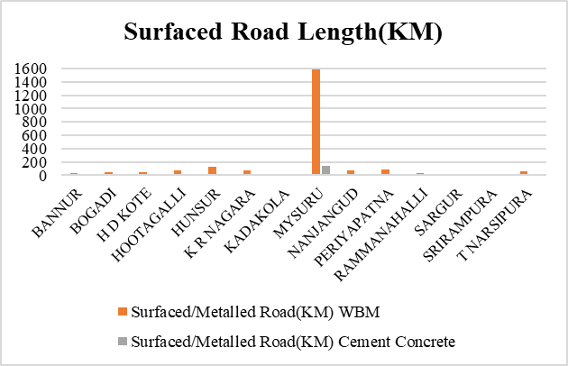
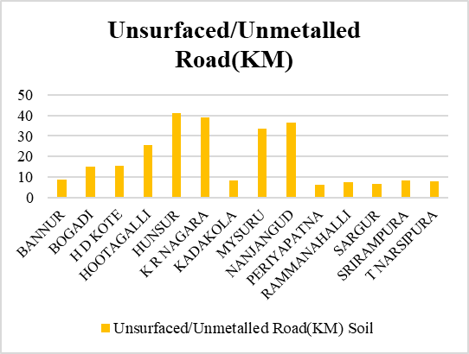
3.Solid Waste Generation
4.Street Lights
URBAN CORE INFRASTRUCTURE
3.Solid Waste Generation:
Mechanical road sweeping is not carried out in the district only manual sweeping is practiced.
All ULB's have dedicated vehicles for Waste collection
All ULB's have SWM site in the District but its not in function in Bogadi , Kadakola ,Ramanahalli, Hootagalli & Srirampura
Transportation of the waste to the processing site is within 10 Km from the towns
Due to non functioning of SWM site in Bogadi, Kadakola, Ramanahalli, Hootagalli & Srirampura, collected waste is sent to Mysore SWM site for scientific disposal.
Present Street Light Location using GIS
4.Street Lights:
Electricity Consumption in all the ULBs is 43.11 MU for the Street Lights.
30.68 Crores is the Energy Cost of all the ULBs for the Street Lights.
Hunsur K R Nagara Sargur H D Kote
5.Transportation (Road Network):
National Highways (NH):
NH 275: Connects Bangalore to Mangalore
NH 766: Connects Mysore to Kollegal and beyond.
NH 150A: Connects Mysore to Chamarajanagar.
State Highways (SH):
SH 17: Connects Bangalore to Mysore via Ramanagara.
SH 88: Connects Mysore to Nanjangud.
SH 12: Connects Mysore to Madikeri
SH 90:Connects Hunsur to Periyapatna
SH 33:Connects Kollegal and Bannur
SH 79:Conects T Narsipur to Bannur
SH 86:Connects T Narsipur and Kollegal
SH 85:Connects Mysore,Hassan and Holenarsipura
SH 81:Connects Nanjungud to Chamrajnagar
Periyapatna Nanjangud
T N Pura Bannur
5.Transportation
Infrastructure present in the ULBs:
Railways:
Railways also play a major role in connectivity.
There are 16 Railways Station ,Mysore Railway Station is the main Station.
SCHOOL OF PLANNING AND ARCHITECTURE
NAME: MAHAM KAUSAR
REV/EXM:02
DISTRICT DEVELOPMENT PLAN FOR MYSURU DISTRICT
CLASS:3rd Sem, MTech in URP
DRW:03
REG NO:P01ZZ23T107004

